Slide 1

CAFFE
Brewing Deep Networks With Caffe

Slide 2
Contents
Why Caffe?
Deploy a common network
Finetune
Tricks for Caffe
Embed Caffe in your application
Custom operation

Slide 3
Why caffe?
Easy common network deploy, friendly to custom network
Pure C++ / CUDA architecture
1. command line, Python, MATLAB interfaces
2. fast, best for industry
Suit for programmers(my view)
1. best used in Linux(my view)
2. modularity
3. C++, a must for programmers

Slide 4
Deploy a common network & Finetune
Deploy
Write two files, then train and test it!
one for network definition, example on minist
one for hyper-parameters, example on minist
This is enough for common networks!
Finetune
In the network definition file, simply fix lr_mult to 0 for the unchanged layers.
layer { ···
param { lr_mult: 0 # for W}
param { lr_mult: 0 # fow b}}

Slide 5
Tricks -- pretend to be an expert on Caffe
Caffe model to TensorFlow
Visualization
Visualize network
Visualize filters and feature maps
Deep visualization

Slide 6

Embed Caffe in your application
One day, you are writing a program, which needs some image features. You have been boring on features such as HOG, SIFT. Then you say, give convolution neural network a try, maybe even the first layer’s feature in a CNN is much better than HOG. But how?
Here are three ways.

Slide 7

Embed Caffe in your application
C++: Embed your application in Caffe
For example, to get deep features from modifying this example.
What you need to do is :
a. insert the following line at the right position
b. delete code irrelevant to your program.
c. complete your code
d. compile Caffe & run your program

Slide 8
Embed Caffe in your application
2. C++: Treat Caffe as a library
a. write code on extract deep features, example
b. write CMakeLists.txt or Makefile, including Caffe library, example
c. build your project
3. Python:
The Python code for Visualize filters and feature maps already contains extracted deep features. Just copy it.

Slide 9

Custom operation
One day, you have a excited idea on convolution neural network. But that requires you to modify the source code. Maybe Tensorflow? Then you google custom operation tensorflow and get a answer here that:
Wait! Write an operation calling Caffe in Tensorflow?!
Well, let’s use Caffe directly.

Slide 10
Caffe code architecture
First, let’s briefly see the Caffe code architecture.
It is very clear, and very similar to our cs231n homework.
Blob: store data, 4-dimension [batch size, channels, height, width]
Layer: read data/conv/relu/pool/full connected/dropout/loss etc...
Net: connect layers to form the whole network
Solver: optimization(Adagrad, Adam, etc…) and read/save model.

Slide 11
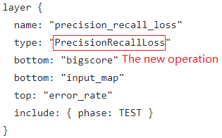
Custom operation
1. Add a class declaration for your layer to
common_layers.hpp/data_layers.hpp/loss_layers.hpp/neuron_layers.hpp/ vision_layers.hpp
2. Implement your layer in layers/your_layer.cpp
You may also implement the GPU versions Forward_gpu and Backward_gpu in layers/your_layer.cu
Which needs program skills on CUDA. CUDA skill should be a huge plus for programmers.
3. Add your layer to proto/caffe.proto, updating the next available ID.
4. Make your layer createable by adding it to layer_factory.cpp
Write tests in test/test_your_layer.cpp.
Compile Caffe and Write network definition as usual. For example:
More detail on these steps here.

Slide 12
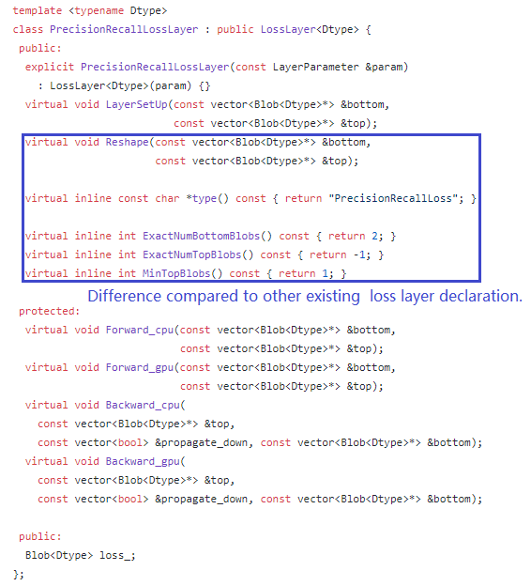
Custom operation
Implementation of PrecisionRecallloss, code[1]
Declaration in loss_layers.hpp
Implement Forward_cpu, Backward_cpu and other functions needed for custom operation in precision_recall_loss_layer.cpp
Simply copy the CPU implementation
code in CUDA implementation(disable CUDA)
Unit test is omitted here, so make runtest command would fail, but we still can call PrecisionRecallloss.
[1] Hierarchically Fused Fully Convolutional Network for Robust Building Extraction ACCV 2016

Slide 13
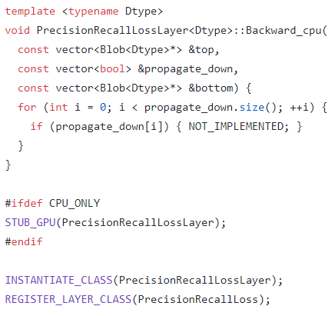
Custom operation
Implementation of PrecisionRecallloss, code[1]
Declaration in loss_layers.hpp
Implement Forward_cpu, Backward_cpu and other functions needed for custom operation in precision_recall_loss_layer.cpp
Simply copy the CPU implementation
code in CUDA implementation(disable CUDA)
Unit test is omitted here, so make runtest command would fail, but we still can call PrecisionRecallloss.
[1] Hierarchically Fused Fully Convolutional Network for Robust Building Extraction ACCV 2016
Part of precision_recall_loss_layer.cpp

Slide 14
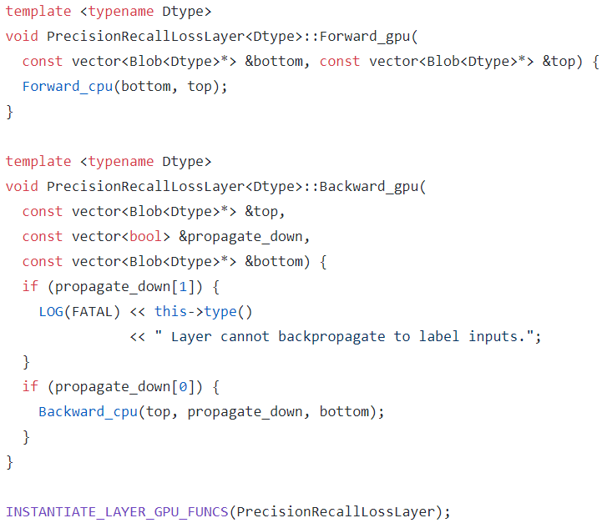
Custom operation
Implementation of PrecisionRecallloss, code[1]
Declaration in loss_layers.hpp
Implement Forward_cpu, Backward_cpu and other functions needed for custom operation in precision_recall_loss_layer.cpp
Simply copy the CPU implementation
code in CUDA implementation(disable CUDA)
Unit test is omitted here, so make runtest command would fail, but we still can call PrecisionRecallloss.
[1] Hierarchically Fused Fully Convolutional Network for Robust Building Extraction ACCV 2016

Slide 15
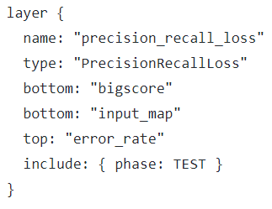
Custom operation
Implementation of PrecisionRecallloss, code[1]
Declaration in loss_layers.hpp
Implement Forward_cpu, Backward_cpu and other functions needed for custom operation in precision_recall_loss_layer.cpp
Simply copy the CPU implementation
code in CUDA implementation(disable CUDA)
Unit test is omitted here, so make runtest command would fail, but we still can call PrecisionRecallloss.
[1] Hierarchically Fused Fully Convolutional Network for Robust Building Extraction ACCV 2016

Slide 16
Question?

Slide 18
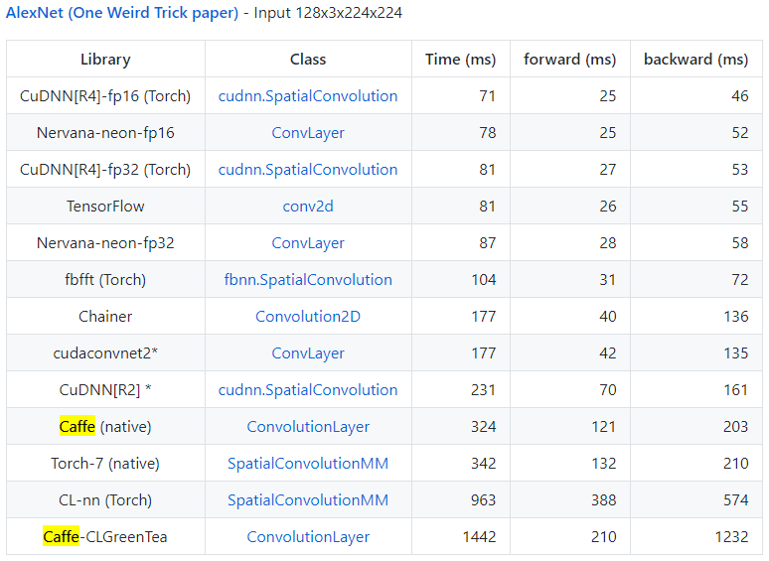
Speed
Microsoft Research Asia and Sensetime also have their internal caffe version.
Sensetime’s internal caffe is 4x+ faster than the original.
6-core Intel Core i7-5930K @ 3.50GHz, NVIDIA Titan X, Ubuntu 14.04 x86_64

